Slide 1
EXPERIMENTAL DESIGN OF THE QUALITY OF WORK LIFE
ANLY 510
HARRISBURG UNIVERSITY OF SCIENCE AND TECHNOLOGY
By:
GROUP 1
Aaina Malhotra
Guruprasad Sivagurunatha Krishnan
Priya Singh
Tanmay Arun Gaonkar
Notes:
To change the image on this slide, select the picture and delete it. Then click the Pictures icon in the placeholder to insert your own image.

Slide 2
CONTENTS
Introduction
Problem Statement
Population Specification
Hypothesis
Experimental Design
Results
Validity/Recommendations

Slide 3
INTRODUCTION
The dataset used for Experimental design is GSS data set. The data has been collected by NORC (National Opinion Research Center).
The General Social Survey (GSS) is a sociological survey used to collect information and keep a historical record of the concerns, experiences, attitudes, and practices of residents of the United States.
GSS is the single best source for sociological and attitudinal trend data covering the United States

Slide 4
PROBLEM STATEMENT
In this Project we are focusing on The Quality of Work life survey module which is a joint project between the National Institute for Occupational Safety and Health (NIOSH) and the National Science Foundation Second bullet point here.
This dataset is chosen for analyzing various number of factors which is affecting quality of work life. There is most of the time work life is imbalanced and result in affecting the health, family life, income etc.
The purpose of this experiment is to study various factors which can lead to imbalanced work life and poor health. To run this experiment, we have analyzed various number of research questions which will help us in proving the relationship between various factors.

Slide 5
POPULATION SPECIFICATION
The population sample/data was collected from general society survey (GSS) data. The general society survey consisted of adults (18+) living in household and working professionals.
In this survey, quota sampling is used with a quota based on sex, age, and employment status.
The sample sizes for the 2000 and 2010 studies were 2,817 and 2,044.

Slide 6
HYPOTHESIS
How is Quality of work life imbalance differing in different age groups?
How does Quality of work life imbalance differ in Male and Female?
How is Income related to Job satisfaction, Work satisfaction and Good life? Does it impact work life?
How much Quality of work life is impacted by losing job and unemployed?
How is own and rented homes impacting quality of work life?
How is the work life improving over the generation?

Slide 7
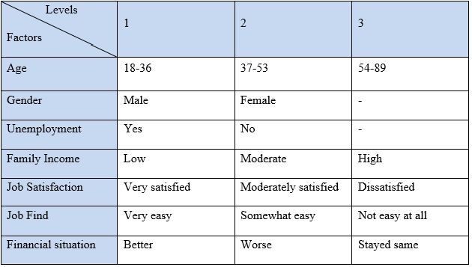
IDENTIFICATION OF VARIABLES
Independent variables:
Gender
Age-group
Dependent Variables:
Family Income
Financial Situation
Unemployment
Job Find
Job satisfaction
Design Factors & levels:

Slide 8
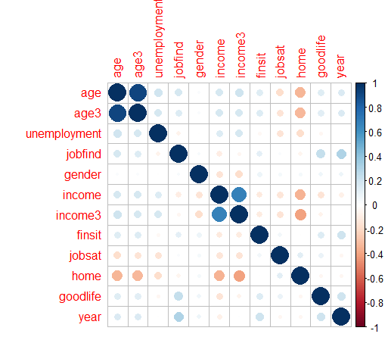
EXPERIMENTAL DESIGN – CORRELATION PLOT
The Good life variable has some relation with the variables:
Age
financial situation,
Job find
But, the relationship is not strongly associated, the correlation is weakly associated.

Slide 9
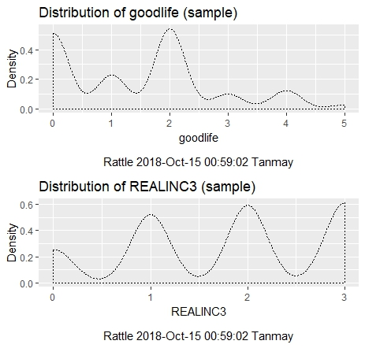
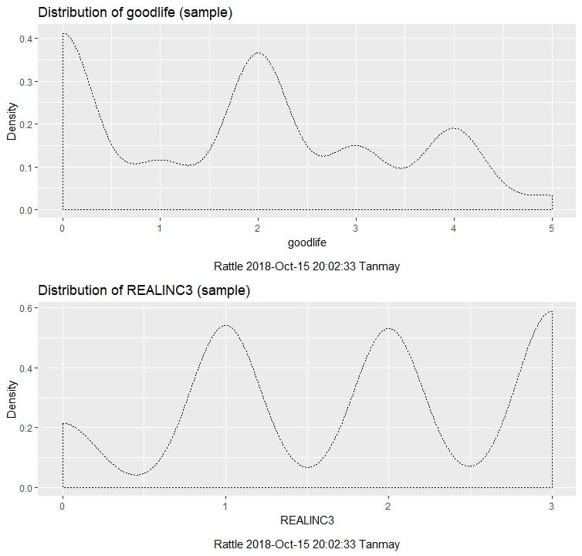
EXPERIMENTAL DESIGN – DISTRIBUTIONS
Year 2000
Year 2010

Slide 10
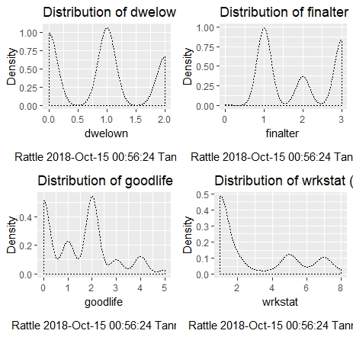
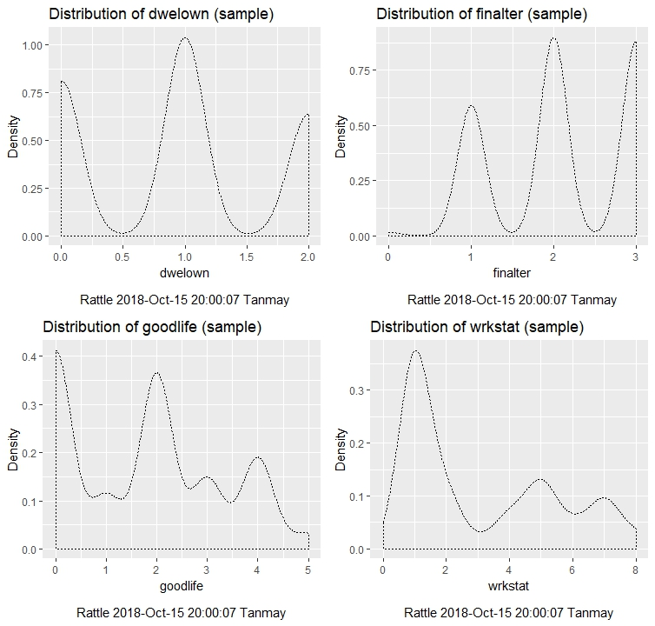
EXPERIMENTAL DESIGN – DISTRIBUTIONS
Year 2000
Year 2010

Slide 11
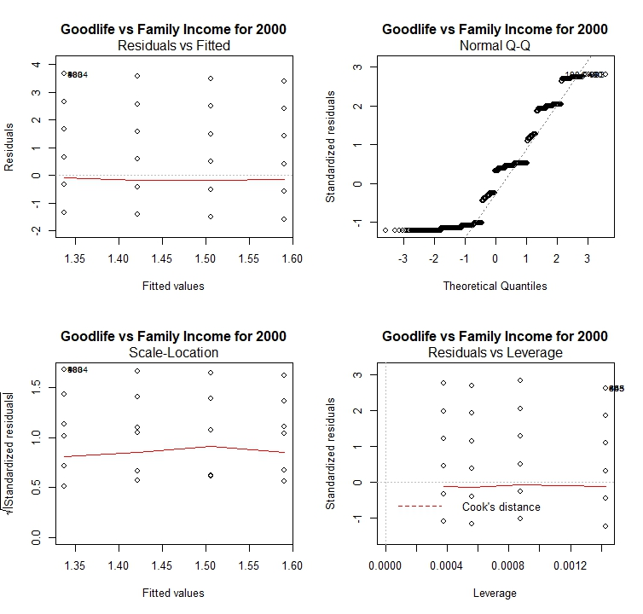
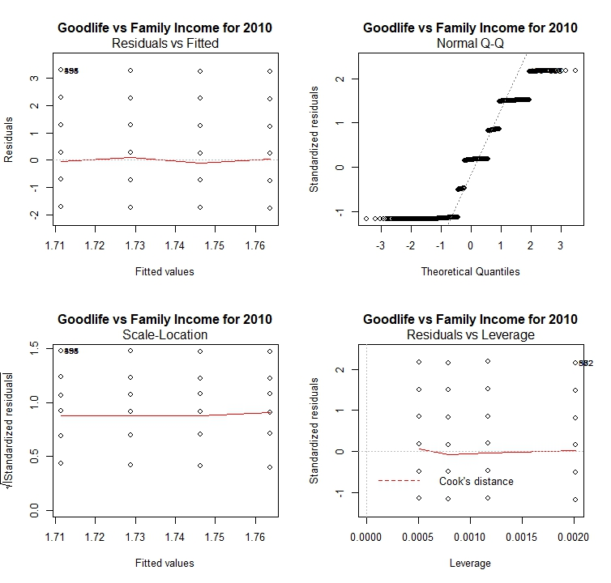
EXPERIMENTAL DESIGN – REGRESSION ANALYSIS
Year 2000
Year 2010

Slide 12
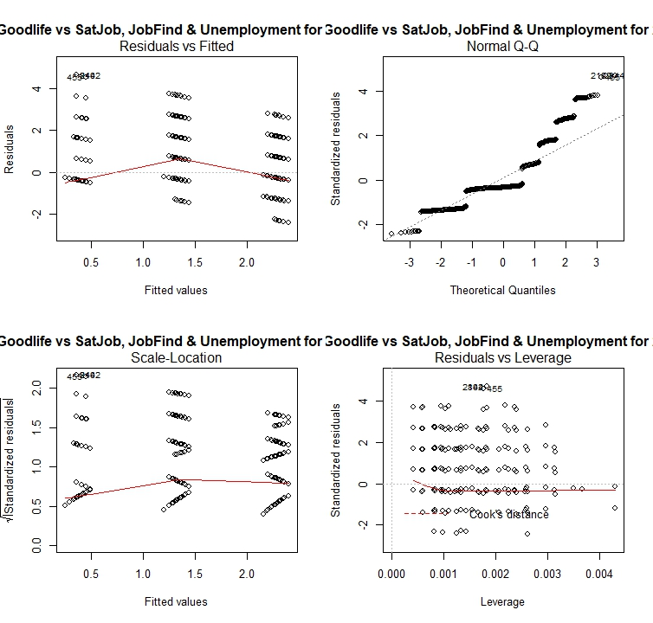
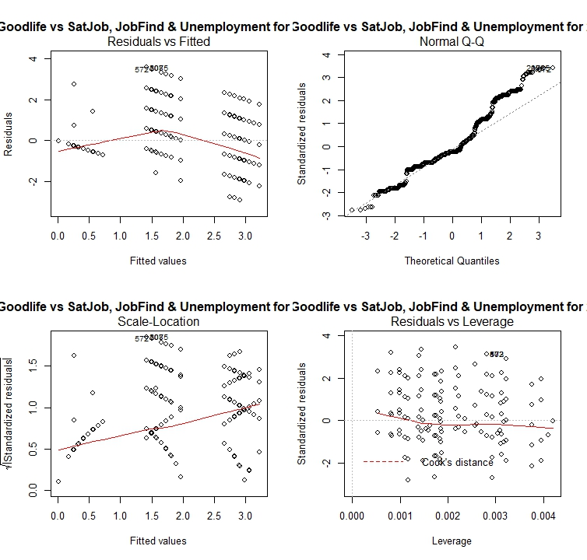
EXPERIMENTAL DESIGN – REGRESSION ANALYSIS
Year 2000
Year 2010

Slide 13
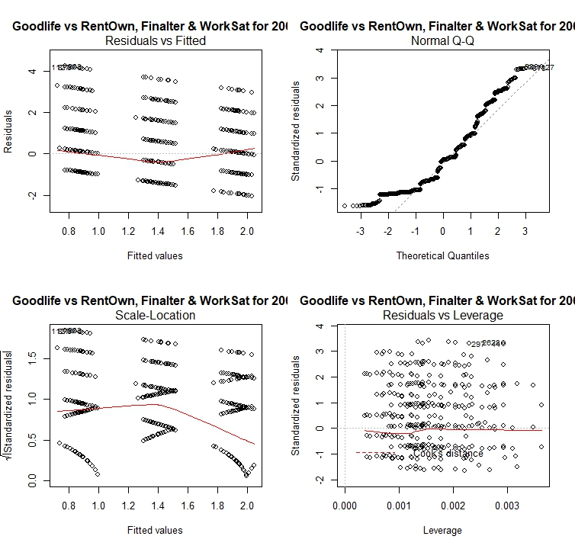
EXPERIMENTAL DESIGN – REGRESSION ANALYSIS
Year 2000
Year 2010

Slide 14
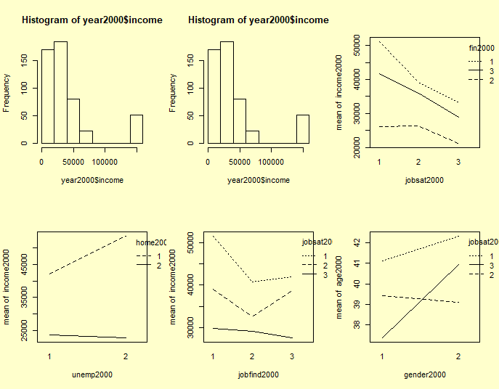
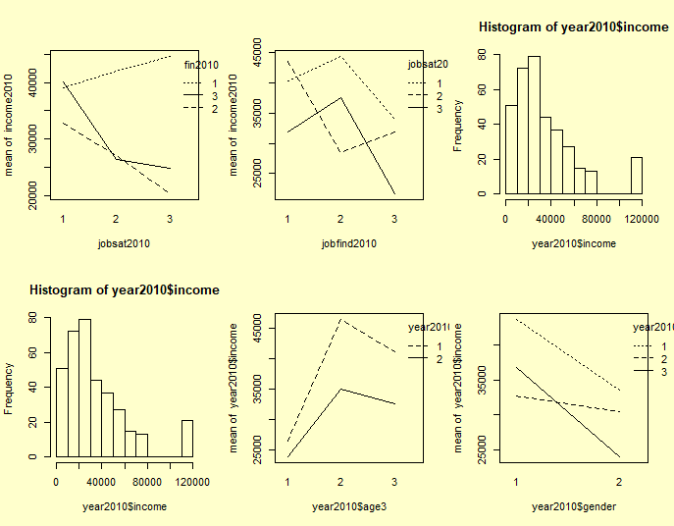
EXPERIMENTAL DESIGN – INTERACTION PLOT AND DISTRIBUTION
Year 2000
Year 2010
Year 2000
Year 2010
In the year 2000 and 2010 it seems that there is a positive skewness in the data income

Slide 15
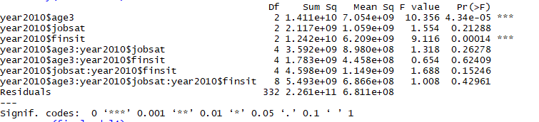
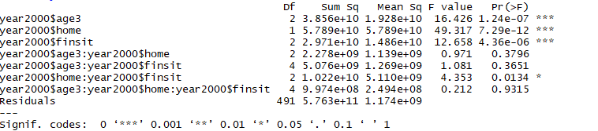
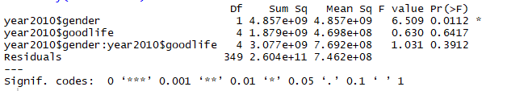
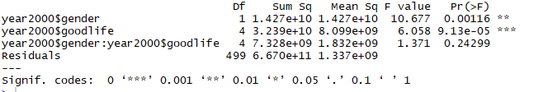
EXPERIMENTAL DESIGN – ANOVA
The Analysis of variance is done using 3K factorial design where we have taken three factors with the levels for both year 2000 and 2010. The interaction between variables were observed by using (*).
model1 <- aov(year2000$income ~ year2000$age3 * year2000$home*year2000$finsit)
model2 <- aov(year2000$income ~ year2000$gender*year2000$goodlife)
Year 2010
Year 2000
YEAR2010
YEAR2000
In the models, we conclude that for year 2000 people having age between 54-79, home , gender, good life and interaction between home: financial situation are statistically significant.
In the models, we conclude that for year 2010 people having age between 54-79, financial situation and gender (less significant) are statistically significant.

Slide 16
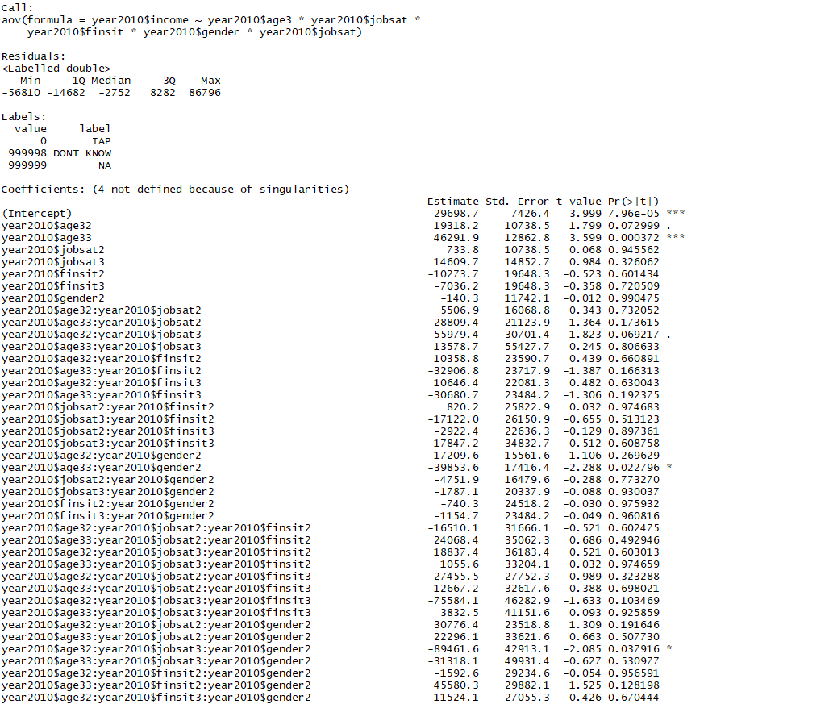
EXPERIMENTAL DESIGN - ANOVA
In the year 2010, the year2010:age33, year2010$age33:year2010$gender2
And
year2010$age32:year2010$jobsat3:year2010$gender2 are statistically significant.

Slide 17


EXPERIMENTAL DESIGN – CHI-SQUARE TEST
Chi – square test was used to analyze the categorical data
H0 : Job satisfaction is independent of the good life levels
HA: Job satisfaction is not independent of the good life levels
In this p-value is very small than the critical value 0.05 and hence we reject null hypothesis that the good life is not independent of their job satisfaction and both variables have a significant relationship.
In this p-value is very small than the critical value 0.05 and hence we reject null hypothesis that the good life is not independent of their financial situation and both variables have a significant relationship.

Slide 18
SUMMARY OF FINDINGS
Correlation:
The Good life data has some relation with variables age, financial situation, job find but it
is not strongly associated, the correlation is weakly associated.
Distributions:
The GoodLife data is not Normal, but slightly Right-skewed.
Out of other variables, only Work Status seems to be Right-skewed as well.
Multiple Linear Regression:
Family Income: The effect of Income is not too significant with respect to Linearity as well, but seems to be improving, evident from the 'Residuals vs leverage' plot.
Job status: Relationship between Goodlife & Job status is Non-Linear, but we can observe that it seems to be improving over time as compared for the years 2000 & 2010, in which it is close to Linear.
Rent own, Financial situation altered over the years, Work Status: These factors had the most significant relationship- There seems to be nearly Linear relationship with the good life in 2000, which is musch better in 2010.
Overall, these factors seem to tilt towards having a Linear relationship with the Quality of life over the passing years.

Slide 19
SUMMARY OF FINDINGS
ANOVA:
In ANOVA test, in the year 2000 people having age between 54-79 are to have good financial situation and income. The females who have age 33 are having good income
And also , females in year 2010 at age 32 are more dissatisfied with the job and they have significant relationship.
CHI – Square Test:
Good life dependent on the job satisfaction and both variables have a significant relationship.
Good life is dependent on their financial situation and both variables have a significant relationship.

Slide 20
VALIDITY & RECOMMENDATIONS
CONVERGENT Validity:
We believe that there is convergent validity; as evident from the fact that, different techniques used for our experimental analysis yield the same result that the 'Financial situation' has the most significant relationship with 'Good life'.
Overall trend with respect to both years 2000 & 2010.
Recommendations:
Missing values- there were some missing values in the data set, which we decided to eliminate to run certain tests like ANOVA, but rather substituting these values as a mean of respective values will help us yield accurate results.
To identify better parameters in this research experiment.

Slide 21



